Slide 1
Designing and Analysis of Algorithms Course Code: ECS 5101/CS514
Dr Rahul Mishra
IIT Patna
Lecture 8

Slide 2
10 | 20 | 50 | 100 | 200 | 500 | 2000
Search 20

Slide 3
Example: Binary Search
Searching for an element k in a sorted array A with n elements
Idea:
Choose the middle element A[n/2]
If k == A[n/2], we are done
If k < A[n/2], search for k between A[0] and A[n/2 -1]
If k > A[n/2], search for k between A[n/2 + 1] and A[n-1]
Repeat until either k is found, or no more elements to search
Requires a smaller number of comparisons than linear search in the worst case (log₂n instead of n)

Slide 4
Binary Search
Binary search operates by iteratively dividing the search range in half, progressively narrowing down the possibilities at each step.
We can denote the time taken for a dataset of size 'n' as T(n), where T(n/2) accounts for the time spent searching within one-half of the dataset, and O(1) represents the constant time required for comparisons and calculations.
This can be expressed using the recurrence relation:
T(n)=T(n/2)+O(1)

Slide 5
Quick Sort
This algorithm follows divide and conquer strategy
Also known as partition exchange algorithm
One of the fastest sorting algorithms
Divide the list of numbers into sub-list until no more division possible.
How do we partition the array ?
Choose pivot – a random element initially (generally 0th index element)
But choosing a right pivot is very important and affect the complexity of algorithm.
Once pivot gets final position then,
<Pivot | Pivot | >Pivot
Notes:
<Pivot
Pivot
>Pivot

Slide 6
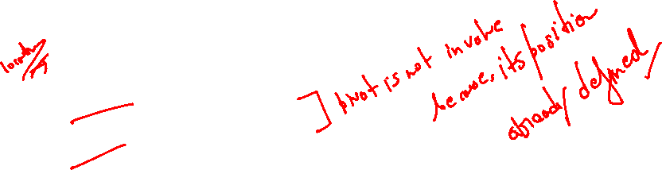
Quick sort
Algorithm Quick_sort(A,low,high): This algorithm sort the elements in ascending order. A is linear array where low is equal to 0 and high is highest index i.e. n-1. A sub algorithm partition is used to split an array into two parts, and it returns final position of pivot element.
If low < high
2. pivot = Partition(A, low, high)
3. Quick_sort(A, low, pivot-1)
4. Quick_sort(A, pivot+1, high)

Slide 7

Quick Sort Partition
Partition(A, low, high) – This algorithm split the array into two parts and fixed the position of pivot element. Function swap is used to exchange the element in array.
pivot = A[low]
left = low+1
right = high
While ( left <= right )
While( A[left] < pivot )
left=left+1
While( A[right] > pivot )
right=right-1
If ( left < right )
swap(A[left],A[right])
swap(A[right], pivot)
Return right

Slide 8
Quick Sort Illustration
left
right
8 | 12 | 14 | 15 | 13 | 10 | 11 | 9 | 4 | 6
low
high
Greater
Smaller
pivot = A[low]

Slide 9
Quick Sort Illustration
left < right
left
right
Swap
8 | 12 | 14 | 15 | 13 | 10 | 11 | 9 | 4 | 6
low
high
Greater
Smaller
pivot = A[low]
FOUND
FOUND

Slide 10
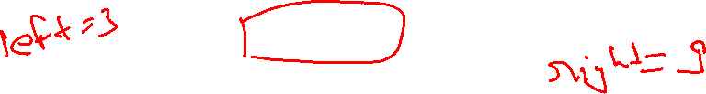
Quick Sort Illustration
left < right
left
Swap
right
8 | 6 | 14 | 15 | 13 | 10 | 11 | 9 | 4 | 12
low
high
Greater
Smaller
pivot = A[low]
FOUND
FOUND

Slide 11
Quick Sort Illustration
left
right
8 | 6 | 4 | 15 | 13 | 10 | 11 | 9 | 14 | 12
low
high
Greater
Smaller
pivot = A[low]

Slide 12
Quick Sort Illustration
left
right
8 | 6 | 4 | 15 | 13 | 10 | 11 | 9 | 14 | 12
low
high
Greater
Smaller
pivot = A[low]
FOUND

Slide 13
Quick Sort Illustration
left
right
8 | 6 | 4 | 15 | 13 | 10 | 11 | 9 | 14 | 12
low
high
Greater
Smaller
pivot = A[low]
FOUND

Slide 14
Quick Sort Illustration
left
right
8 | 6 | 4 | 15 | 13 | 10 | 11 | 9 | 14 | 12
low
high
Greater
Smaller
pivot = A[low]
FOUND

Slide 15
Quick Sort Illustration
left
right
8 | 6 | 4 | 15 | 13 | 10 | 11 | 9 | 14 | 12
low
high
Greater
Smaller
pivot = A[low]
FOUND

Slide 16
Quick Sort Illustration
left
right
8 | 6 | 4 | 15 | 13 | 10 | 11 | 9 | 14 | 12
low
high
Greater
Smaller
pivot = A[low]
FOUND

Slide 17
Quick Sort Illustration
left > right
right
left
Swap
8 | 6 | 4 | 15 | 13 | 10 | 11 | 9 | 14 | 12
low
high
Greater
Smaller
pivot = A[low]
FOUND
FOUND

Slide 18
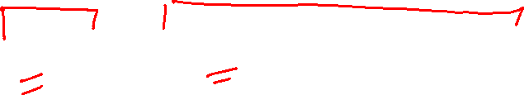
Quick Sort Illustration
4 | 6 | 8 | 15 | 13 | 10 | 11 | 9 | 14 | 12
Final Position

Slide 19
Quick Sort Illustration
left
right
left
right
4 | 6
8
15 | 13 | 10 | 11 | 9 | 14 | 12
low
high
low
high
pivot = A[low]

Slide 20
Quick Sort Illustration
left
right
4
6
8
12 | 13 | 10 | 11 | 9 | 14
15
low
high
4 | 6 | 8
11 | 9 | 10
12
13 | 14
15
4 | 6 | 8
10 | 9
11
12
13
14
15

Slide 21
Quick Sort Illustration
Final Output:
4 | 6 | 8 | 9 | 10 | 11 | 12 | 13 | 14 | 15

Slide 22
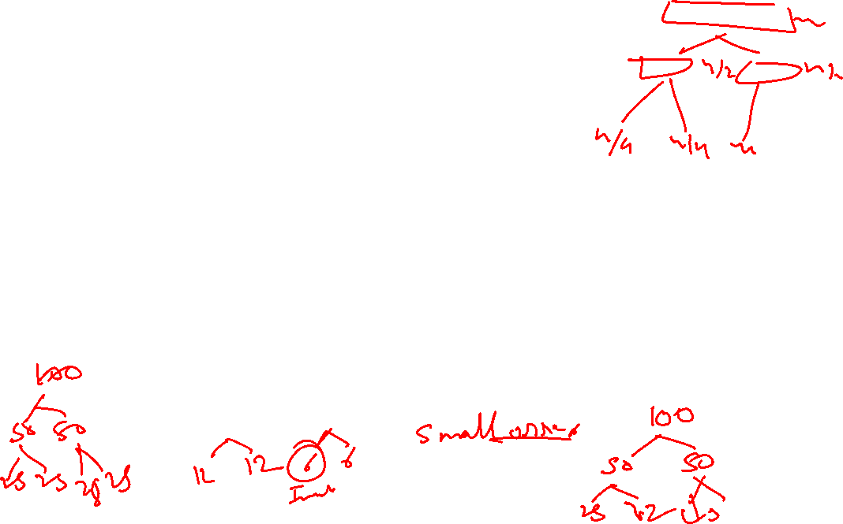
Small Arrays
For very small arrays, quick sort does not perform as well as insertion sort
Do not use quick sort recursively for small arrays
Use a sorting algorithm that is efficient for small arrays, such as insertion sort.
When using quick sort recursively, switch to insertion sort when the sub-arrays have between 5 to 20 elements (10 is usually good).
saves about 15% in the running time.
avoids taking the median of three when the sub-array has only 1 or 2 elements.

Slide 23
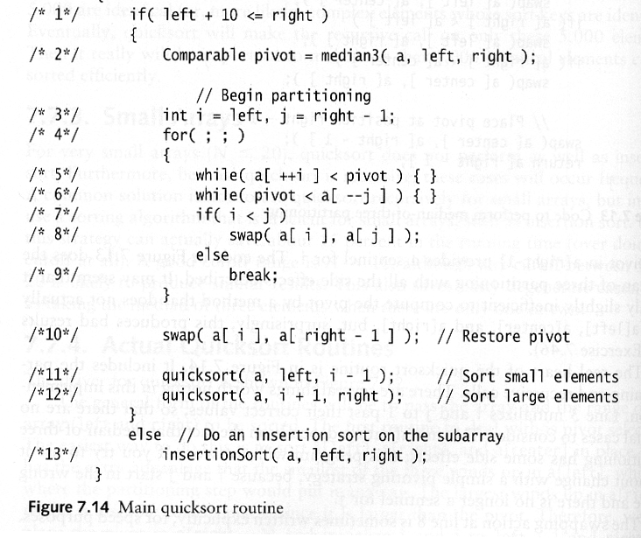
Quick Sort: Pseudo-code
Choose pivot
Partitioning
Recursion
For small arrays

Slide 24
Partitioning Part
The partitioning code we just saw works only if pivot is picked as median-of-three.
A[left] ≤ pivot and A[right] ≥ pivot
Need to partition only
A[left + 1, …, right – 2]
j will not run past the beginning
because A[left] ≤ pivot
i will not run past the end
because A[right-1] = pivot

Slide 25
Quick Sort Faster Than Merge Sort
Both quick sort and merge sort take O(N log N) in the average case.
But quick sort is faster in the average case:
The inner loop consists of an increment/decrement (by 1, which is fast), a test and a jump.
There is no extra juggling as in merge sort.
inner loop

Slide 26
Analysis
26
Assumptions:
A random pivot (no median-of-three partitioning)
No cutoff for small arrays ( to make it simple)
If the number of elements in S is 0 or 1, then return (base case).
Pick an element v in S (called the pivot).
Partition the elements in S except v into two disjoint groups:
S₁ = {x ∈ S – {v} | x ≤ v}
S₂ = {x ∈ S – {v} | x ≥ v}
Return {QuickSort(S₁) + v + QuickSort(S₂)}

Slide 27



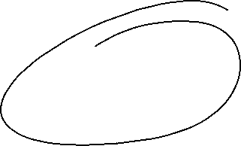
Analysis (2)
Running time
pivot selection: constant time, i.e. O(1)
partitioning: linear time, i.e. O(N)
running time of the two recursive calls
T(N)= T(i) + T(N – i – 1) + cN
i: number of elements in S1
c is a constant

Slide 28
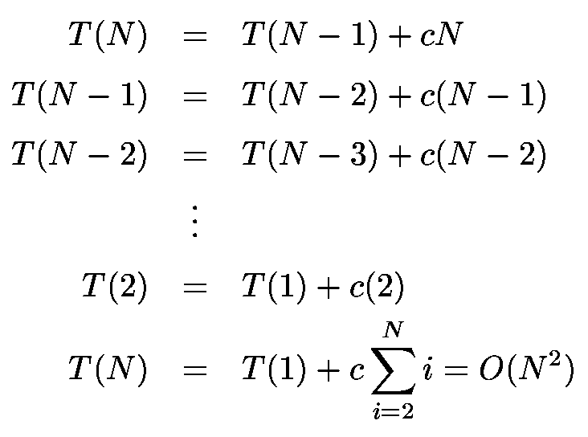
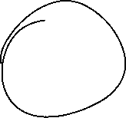

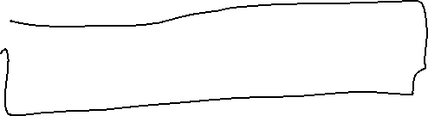

Worst-Case Scenario
What will be the worst case?
The pivot is the smallest element, all the time
Partition is always unbalanced

Slide 29

Best-Case Scenario
What will be the best case?
Partition is perfectly balanced.
Pivot is always in the middle (median of the array).
T(N) = T(N/2) + T(N/2) + cN = 2T(N/2) + cN
This recurrence is similar to the merge sort recurrence.
The result is O(NlogN).

Slide 30
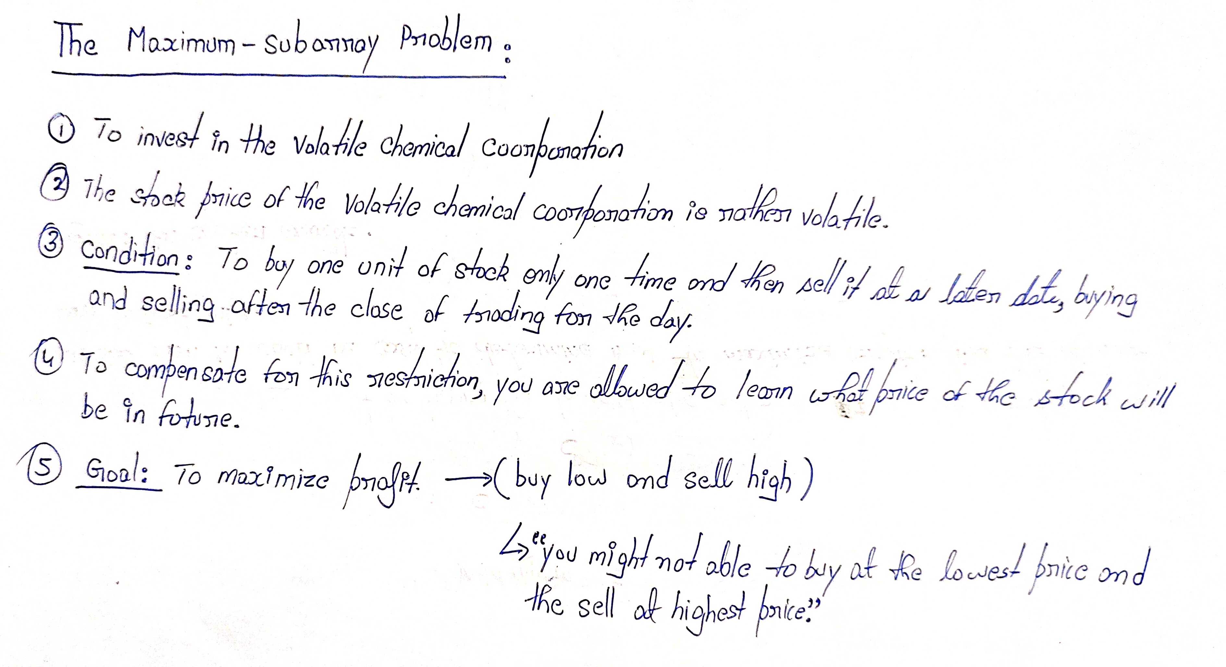
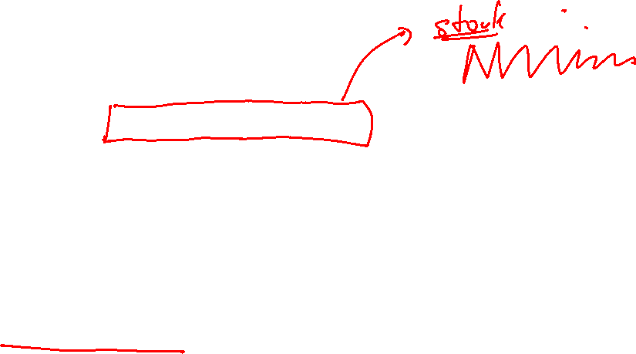

Slide 31
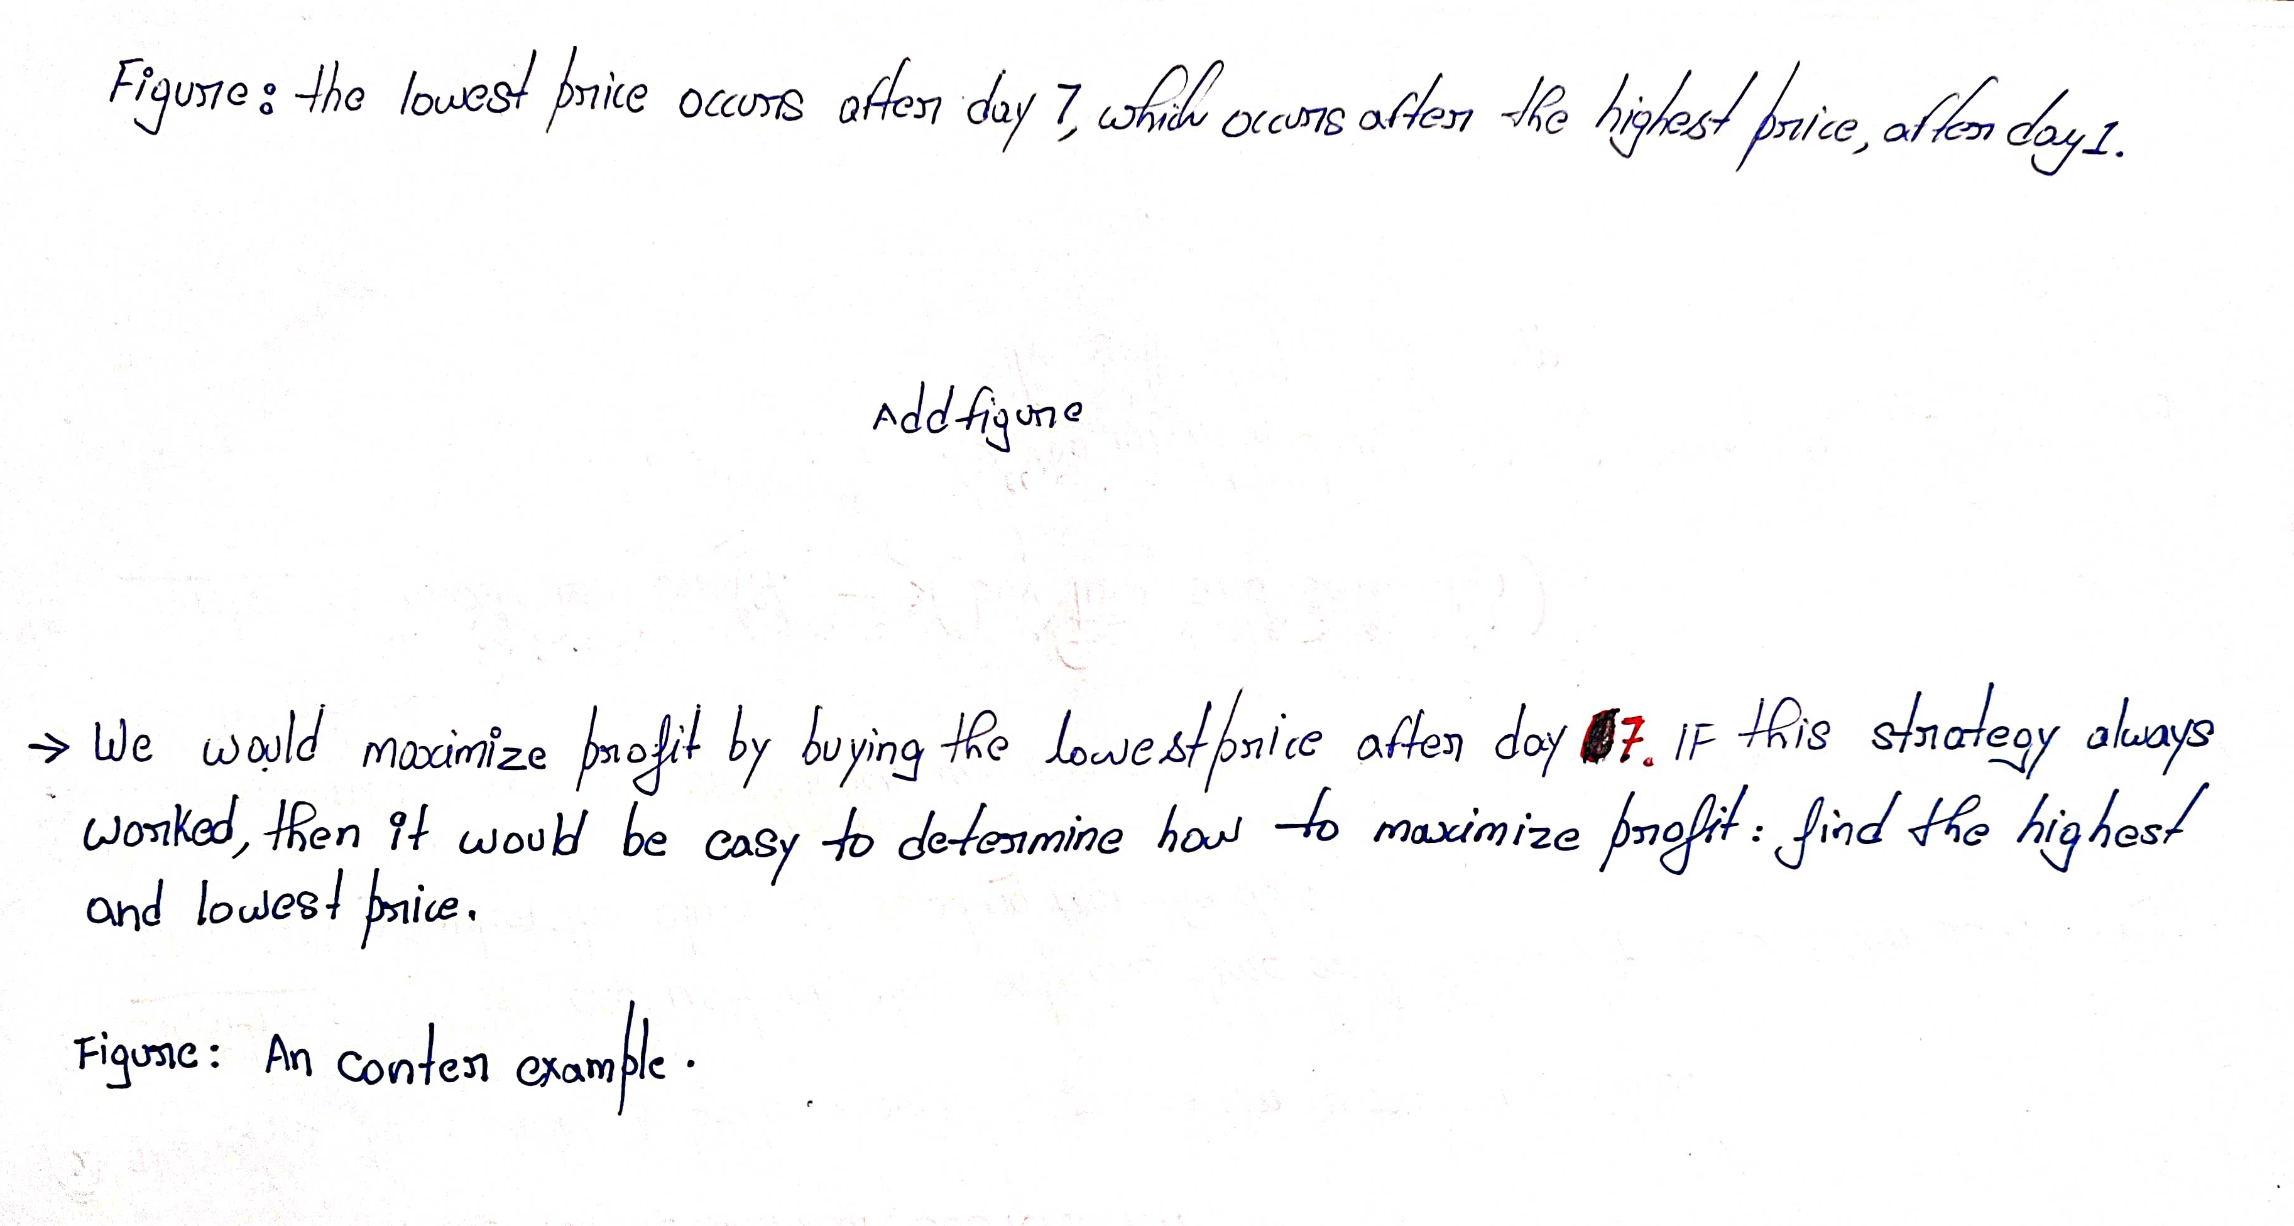
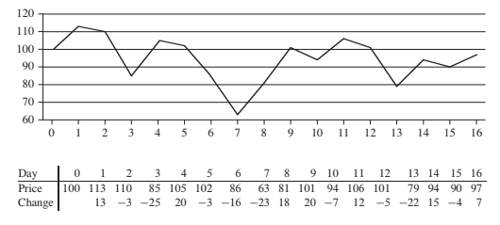
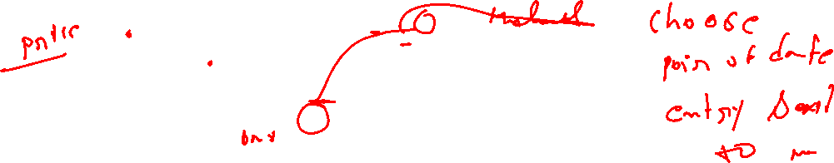

Slide 32
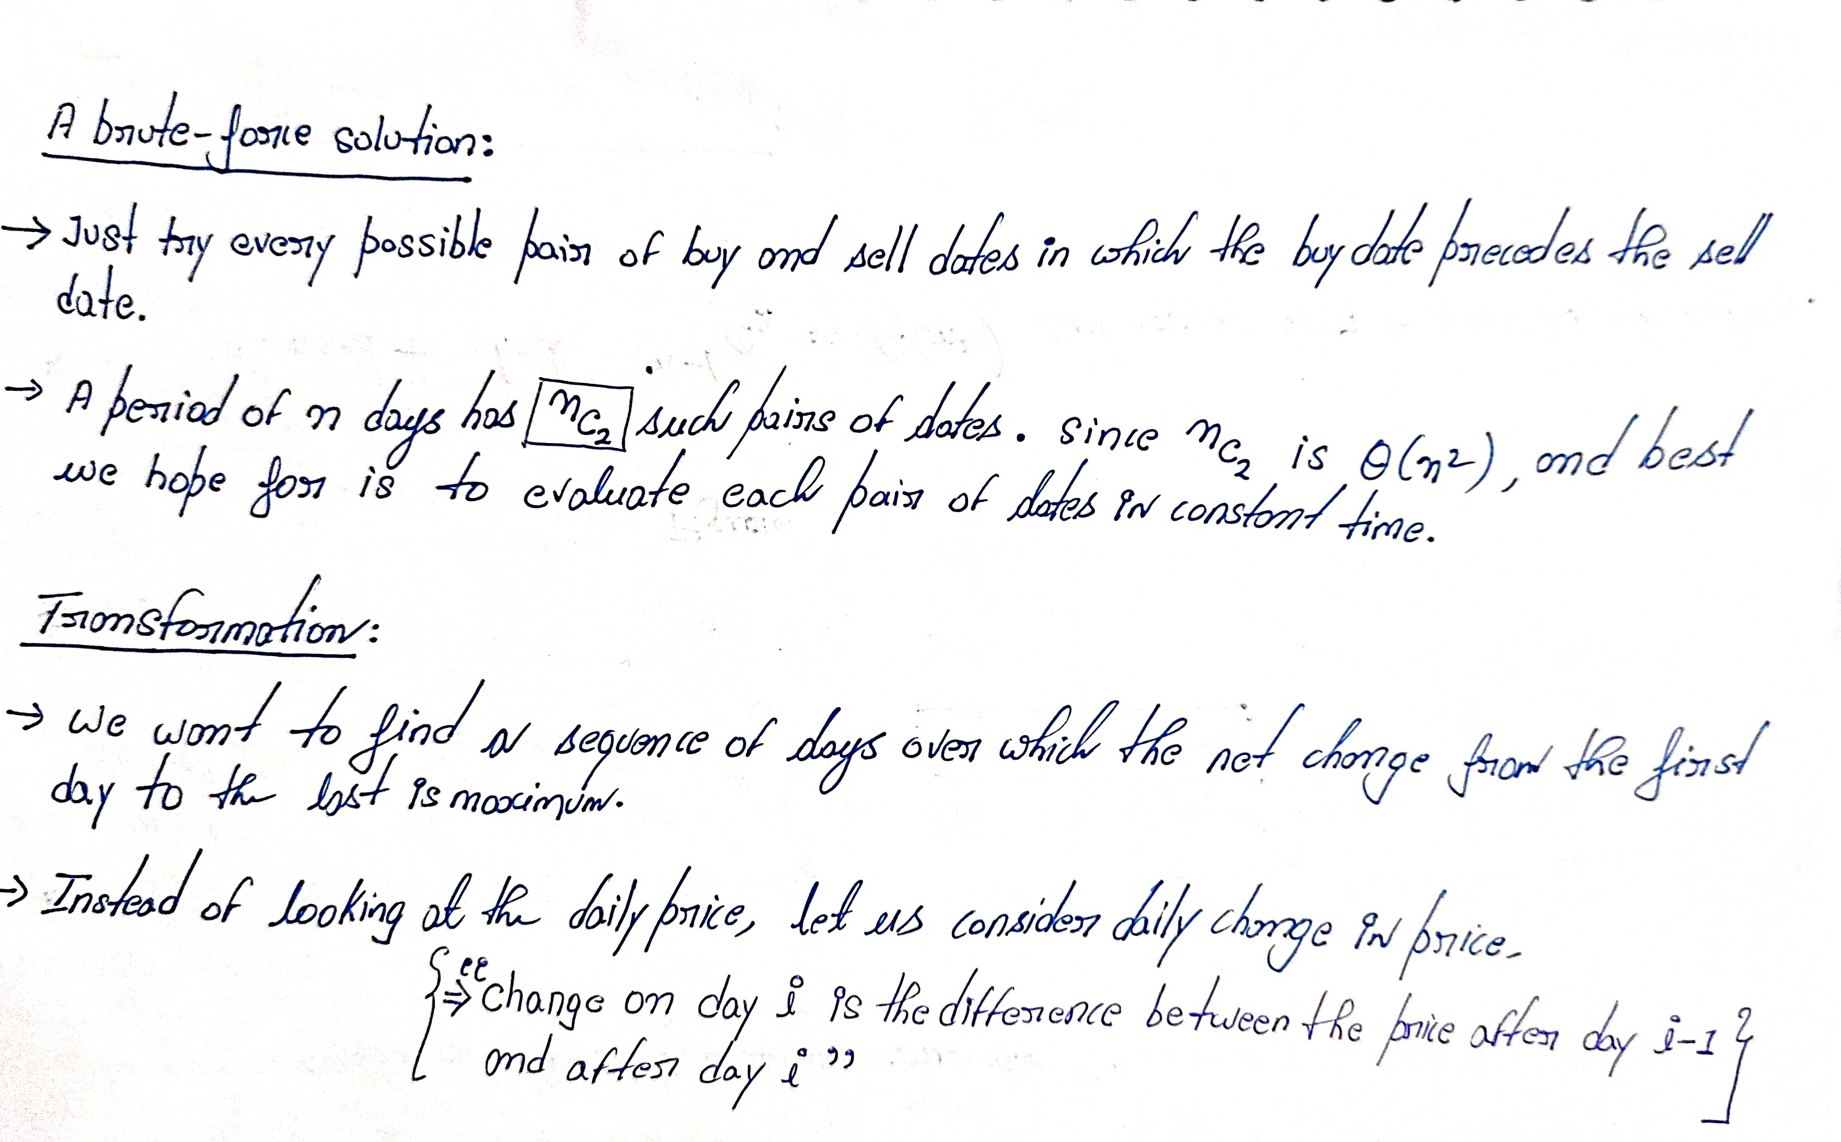

Slide 33
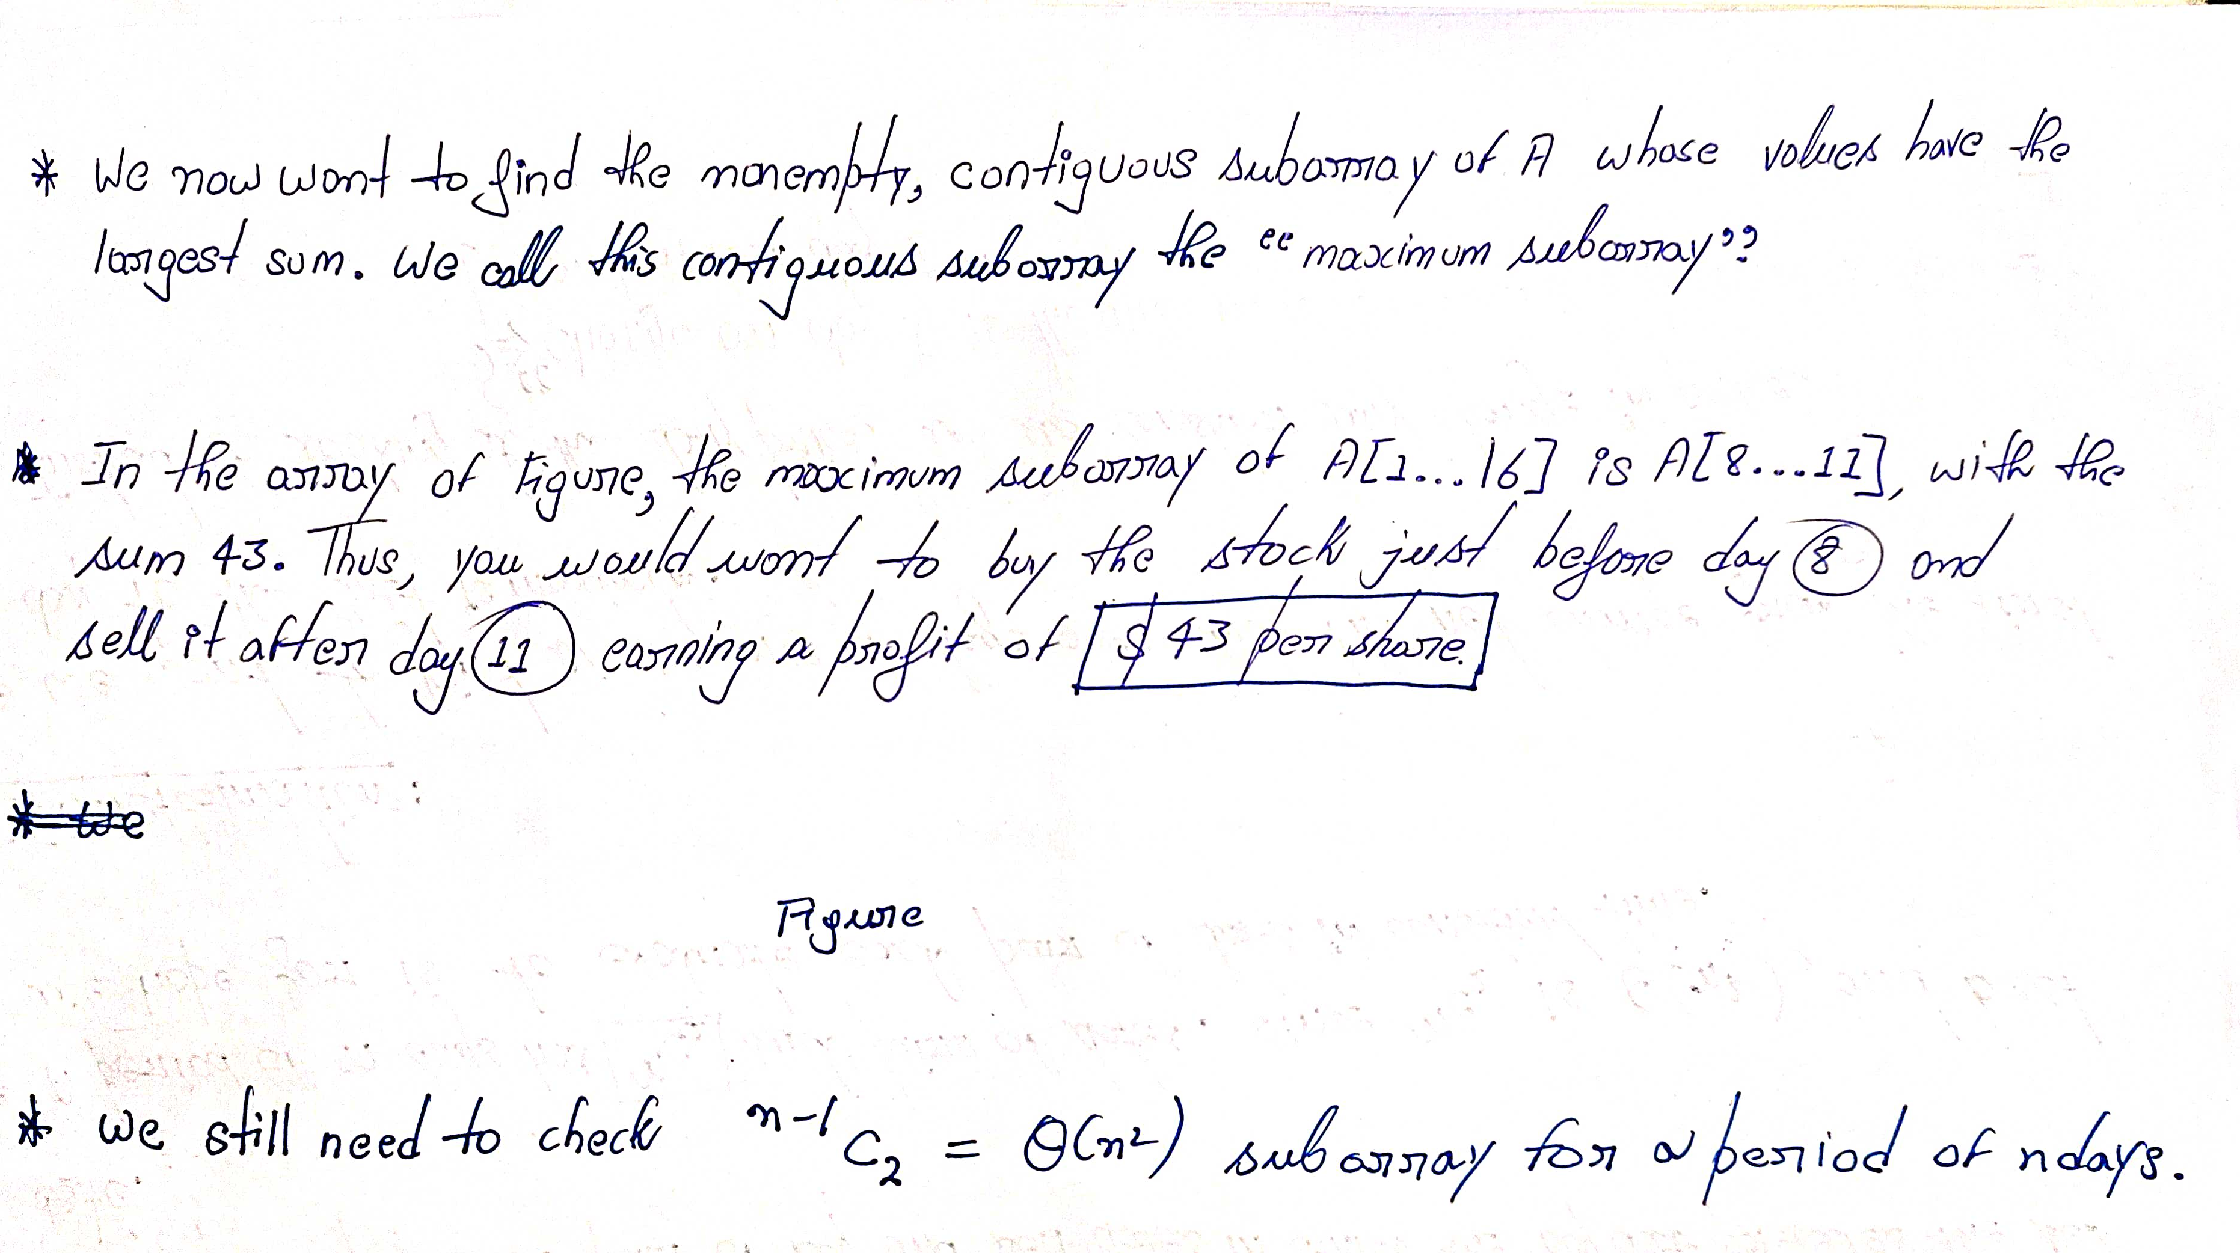

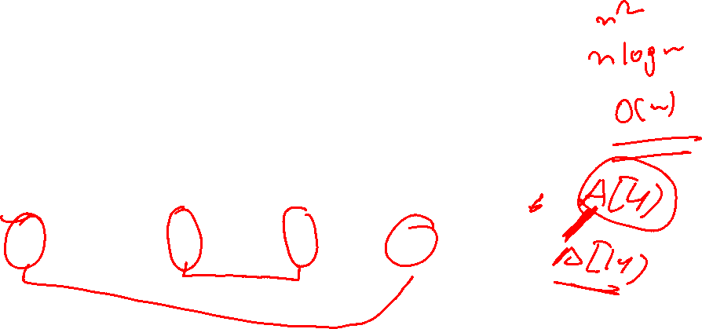
33

Slide 34
Maximum-sum contiguous subarray
Given an array A[ ] of n numbers, find the maximum sum found in any contiguous subarray
A zero length subarray has maximum 0
Example:
if A[ ] contains -2, 5, -3, 6, -1, then the maximum sum will be 5-3+6 = 8
if A[ ] contains 10, 15, -3, -4, -2, -1, 8, 5, then the maximum sum will be 28 (all numbers added together)
O(n²), O(n log n), O(n) time algorithms

Slide 35
Brute-force algorithm

Slide 36
Brute-force algorithm
All possible contiguous subarrays
A[1..1], A[1..2], A[1..3], ..., A[1..(n-1)], A[1..n]
A[2..2], A[2..3], ..., A[2..(n-1)], A[2..n]
...
A[(n-1)..(n-1)], A[(n-1)..n]
A[n..n]
How many of them in total?
Algorithm: For each subarray, compute the sum. Find the subarray that has the maximum sum.
O(n²)

Slide 37
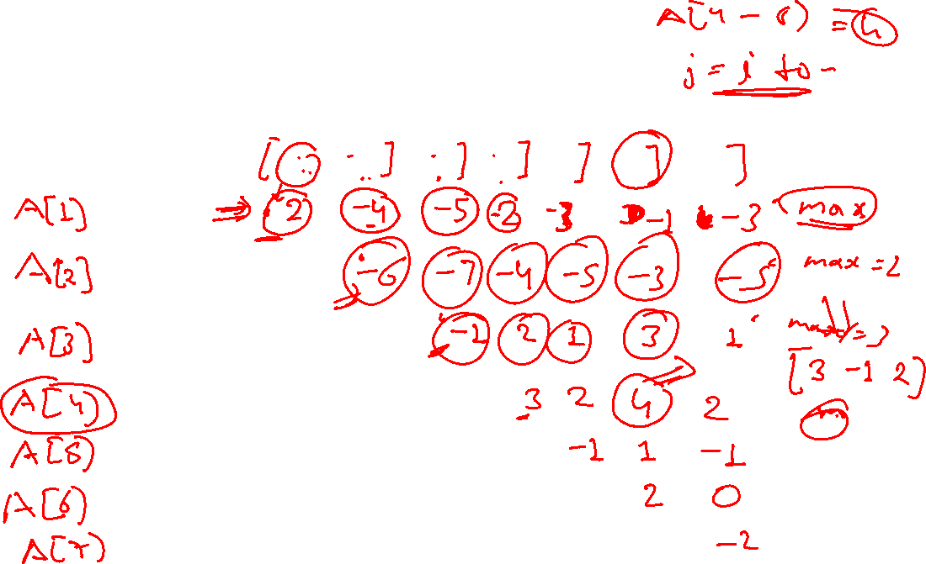
Idea of brute-force algorithm
Example: 2 -6 -1 3 -1 2 -2
sum from A[1]: 2 -4 -5 -2 -3 -1 -3
sum from A[2]: -6 -7 -4 -5 -3 -5
sum from A[3]: -1 2 1 3 1
sum from A[4]: 3 2 4 2
sum from A[5]: -1 1 -1
sum from A[6]: 2 0
sum from A[7]: -2

Slide 38
Brute-force algorithm
Outer loop: index variable i to indicate start of subarray, for 1 ≤ i ≤ n, i.e., A[1], A[2], ..., A[n]
for i = 1 to n do ...
Inner loop: for each start index i, we need to go through A[i..i], A[i..(i+1)], ..., A[i..n]
use an index j for i ≤ j ≤ n, i.e., consider A[i..j]
for j = i to n do ...

Slide 39
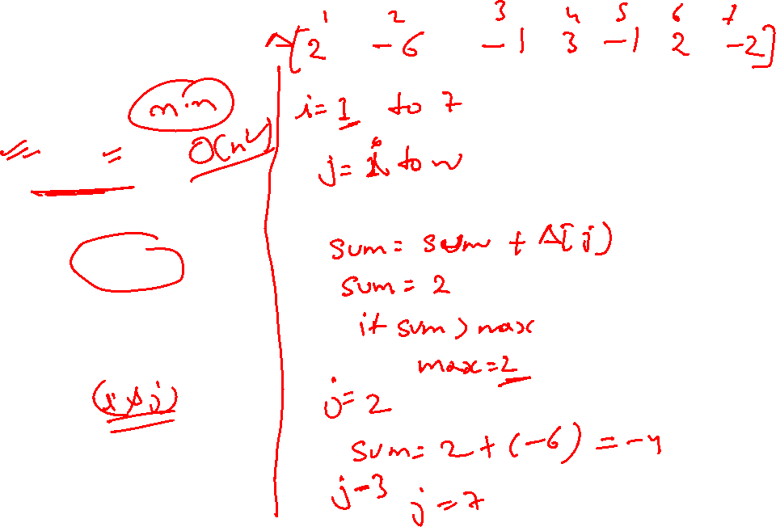
Pseudo code
Time complexity?
O(n²)
max = 0
for i = 1 to n do
begin
sum = 0
for j = i to n do
begin
sum = sum + A[j]
if sum > max
then max = sum
end
end

Slide 40
Divide-and-conquer algorithm

Slide 41
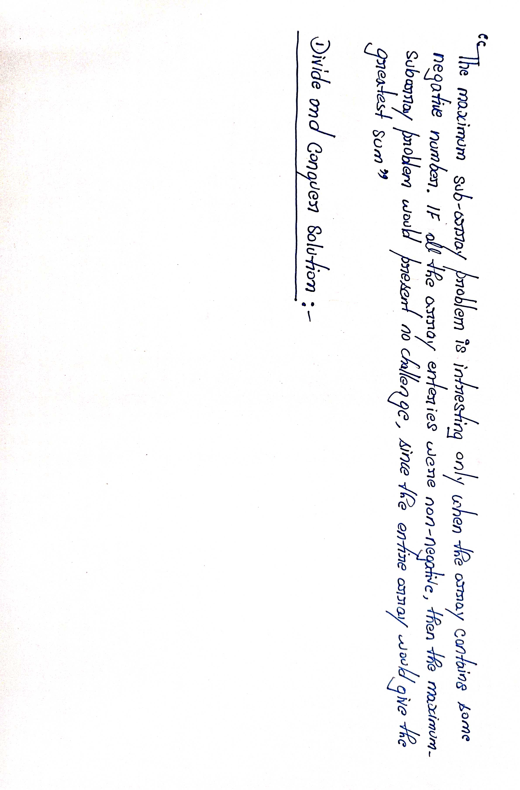


Slide 42
